Slide 1
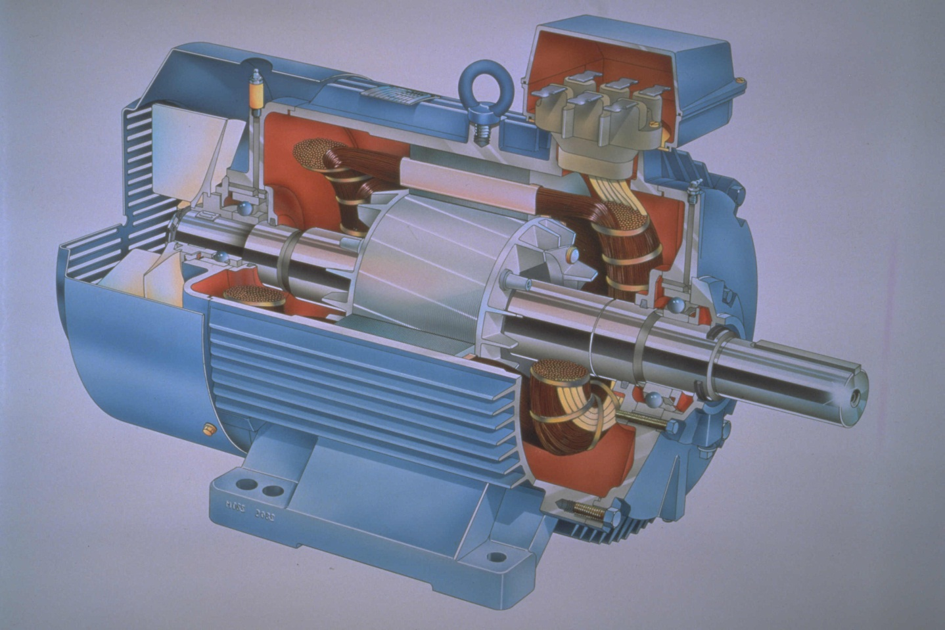
Induction Motors

Slide 2
Introduction
Three-phase induction motors are the most common and frequently encountered machines in industry
simple design, rugged, low-price, easy maintenance
wide range of power ratings: fractional horsepower to 10 MW
run essentially as constant speed from no-load to full load
Its speed depends on the frequency of the power source
not easy to have variable speed control
requires a variable-frequency power-electronic drive for optimal speed control

Slide 3
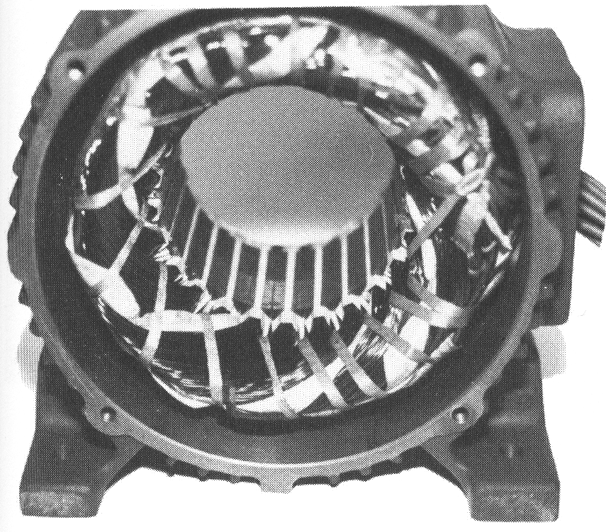
Construction
An induction motor has two main parts
a stationary stator
consisting of a steel frame that supports a hollow, cylindrical core
core, constructed from stacked laminations (why?), having a number of evenly spaced slots, providing the space for the stator winding
Stator of IM

Slide 4
Construction
a revolving rotor
composed of punched laminations, stacked to create a series of rotor slots, providing space for the rotor winding
one of two types of rotor windings
conventional 3-phase windings made of insulated wire (wound-rotor) » similar to the winding on the stator
aluminum bus bars shorted together at the ends by two aluminum rings, forming a squirrel-cage shaped circuit (squirrel-cage)
Two basic design types depending on the rotor design
squirrel-cage: conducting bars laid into slots and shorted at both ends by shorting rings.
wound-rotor: complete set of three-phase windings exactly as the stator. Usually Y-connected, the ends of the three rotor wires are connected to 3 slip rings on the rotor shaft. In this way, the rotor circuit is accessible.

Slide 5
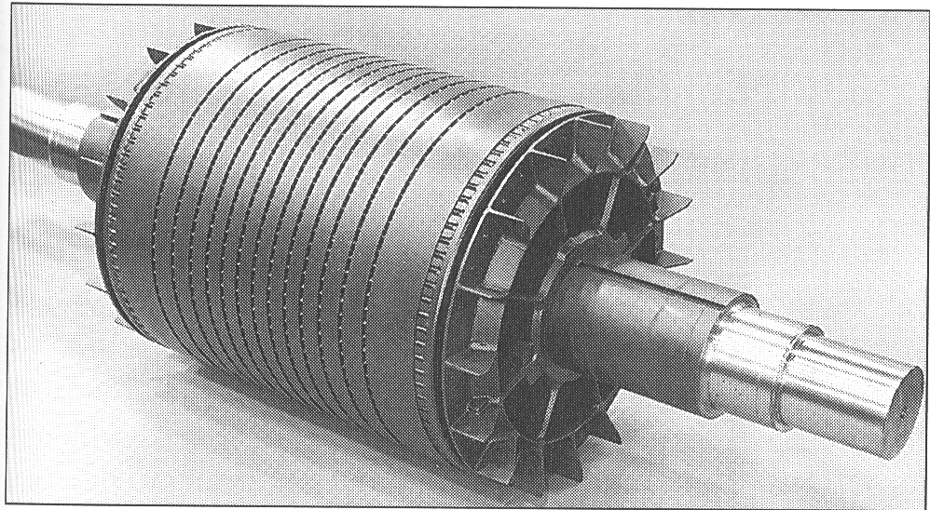
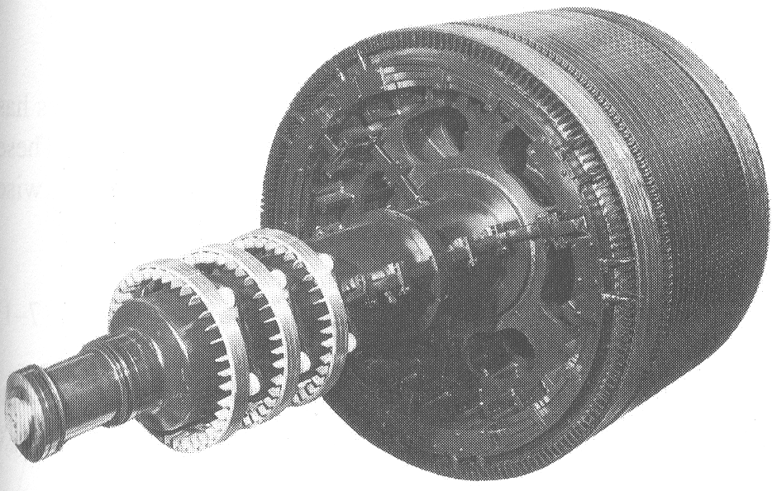
Construction
Squirrel cage rotor
Wound rotor
Notice the slip rings

Slide 6
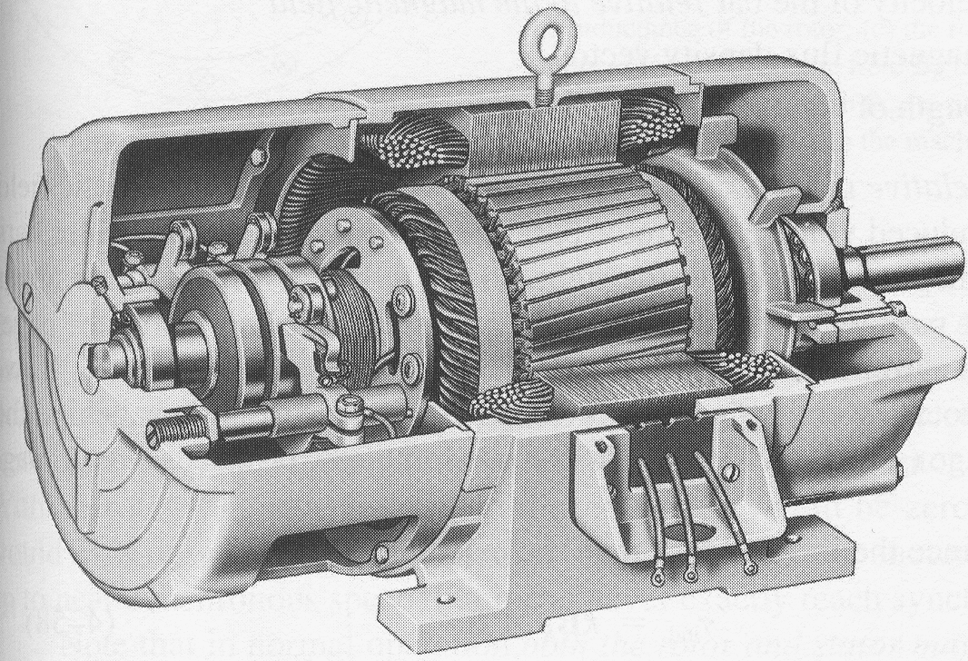
Construction
Slip rings
Cutaway in a typical wound-rotor IM. Notice the brushes and the slip rings
Brushes

Slide 7
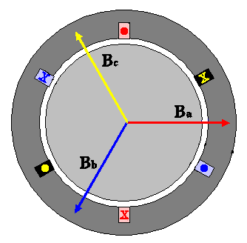
Rotating Magnetic Field
Balanced three phase windings, i.e. mechanically displaced 120 degrees form each other, fed by balanced three phase source
A rotating magnetic field with constant magnitude is produced, rotating with a speed
Where f_{e} is the supply frequency and
P is the no. of poles and n_{sync} is called the synchronous speed in rpm (revolutions per minute)

Slide 8
Synchronous speed
P | 50 Hz | 60 Hz
2 | 3000 | 3600
4 | 1500 | 1800
6 | 1000 | 1200
8 | 750 | 900
10 | 600 | 720
12 | 500 | 600

Slide 9
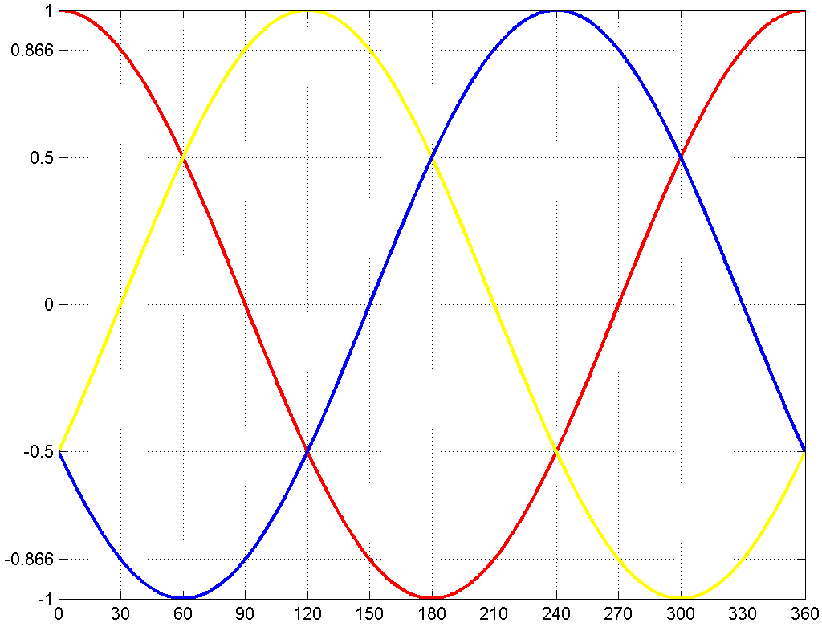
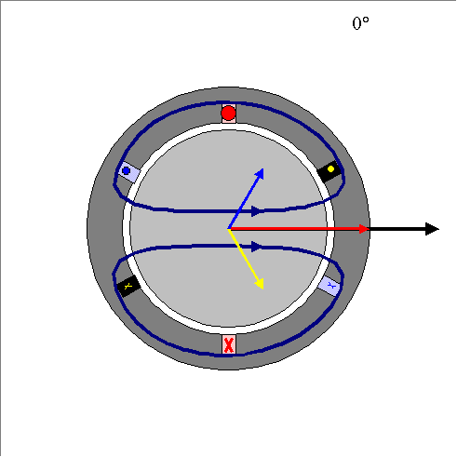
Rotating Magnetic Field

Slide 10
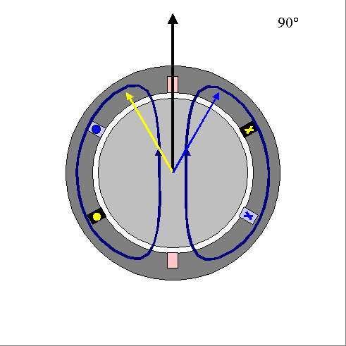
Rotating Magnetic Field

Slide 11
Rotating Magnetic Field

Slide 12
Rotating Magnetic Field

Slide 13
Rotating Magnetic Field

Slide 14
Principle of operation
This rotating magnetic field cuts the rotor windings and produces an induced voltage in the rotor windings
Due to the fact that the rotor windings are short circuited, for both squirrel cage and wound-rotor, and induced current flows in the rotor windings
The rotor current produces another magnetic field
A torque is produced as a result of the interaction of those two magnetic fields
Where τ_{ind} is the induced torque and B_{R} and B_{S} are the magnetic flux densities of the rotor and the stator respectively

Slide 15
Induction motor speed
At what speed will the IM run?
Can the IM run at the synchronous speed, why?
If rotor runs at the synchronous speed, which is the same speed of the rotating magnetic field, then the rotor will appear stationary to the rotating magnetic field and the rotating magnetic field will not cut the rotor. So, no induced current will flow in the rotor and no rotor magnetic flux will be produced so no torque is generated and the rotor speed will fall below the synchronous speed
When the speed falls, the rotating magnetic field will cut the rotor windings and a torque is produced

Slide 16
Induction motor speed
So, the IM will always run at a speed lower than the synchronous speed
The difference between the motor speed and the synchronous speed is called the Slip
Where n_{slip}= slip speed
n_{sync}= speed of the magnetic field
n_{m} = mechanical shaft speed of the motor

Slide 17
The Slip
Where s is the slip
Notice that : if the rotor runs at synchronous speed
s = 0
if the rotor is stationary
s = 1
Slip may be expressed as a percentage by multiplying the above eq. by 100, notice that the slip is a ratio and doesn’t have units

Slide 18
Induction Motors and Transformers
Both IM and transformer works on the principle of induced voltage
Transformer: voltage applied to the primary windings produce an induced voltage in the secondary windings
Induction motor: voltage applied to the stator windings produce an induced voltage in the rotor windings
The difference is that, in the case of the induction motor, the secondary windings can move
Due to the rotation of the rotor (the secondary winding of the IM), the induced voltage in it does not have the same frequency of the stator (the primary) voltage

Slide 19
Frequency
The frequency of the voltage induced in the rotor is given by
Where f_{r} = the rotor frequency (Hz)
P = number of stator poles
n = slip speed (rpm)

Slide 20
Frequency
What would be the frequency of the rotor’s induced voltage at any speed n_{m}?
When the rotor is blocked (s=1) , the frequency of the induced voltage is equal to the supply frequency
On the other hand, if the rotor runs at synchronous speed (s = 0), the frequency will be zero

Slide 21
Torque
While the input to the induction motor is electrical power, its output is mechanical power and for that we should know some terms and quantities related to mechanical power
Any mechanical load applied to the motor shaft will introduce a Torque on the motor shaft. This torque is related to the motor output power and the rotor speed
and

Slide 22
Horse power
Another unit used to measure mechanical power is the horse power
It is used to refer to the mechanical output power of the motor
Since we, as an electrical engineers, deal with watts as a unit to measure electrical power, there is a relation between horse power and watts

Slide 23
Example
A 208-V, 10hp, four pole, 60 Hz, Y-connected induction motor has a full-load slip of 5 percent
What is the synchronous speed of this motor?
What is the rotor speed of this motor at rated load?
What is the rotor frequency of this motor at rated load?
What is the shaft torque of this motor at rated load?

Slide 24
Solution

Slide 25
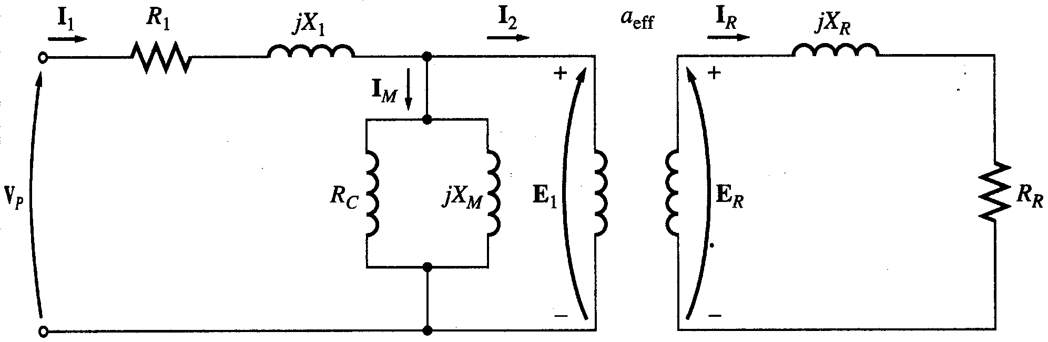
Equivalent Circuit
The induction motor is similar to the transformer with the exception that its secondary windings are free to rotate
As we noticed in the transformer, it is easier if we can combine these two circuits in one circuit but there are some difficulties

Slide 26
Equivalent Circuit
When the rotor is locked (or blocked), i.e. s =1, the largest voltage and rotor frequency are induced in the rotor, Why?
On the other side, if the rotor rotates at synchronous speed, i.e. s = 0, the induced voltage and frequency in the rotor will be equal to zero, Why?
Where E_{R0} is the largest value of the rotor’s induced voltage obtained at s = 1(loacked rotor)

Slide 27
Equivalent Circuit
The same is true for the frequency, i.e.
It is known that
So, as the frequency of the induced voltage in the rotor changes, the reactance of the rotor circuit also changes
Where X_{r0} is the rotor reactance
at the supply frequency
(at blocked rotor)

Slide 28
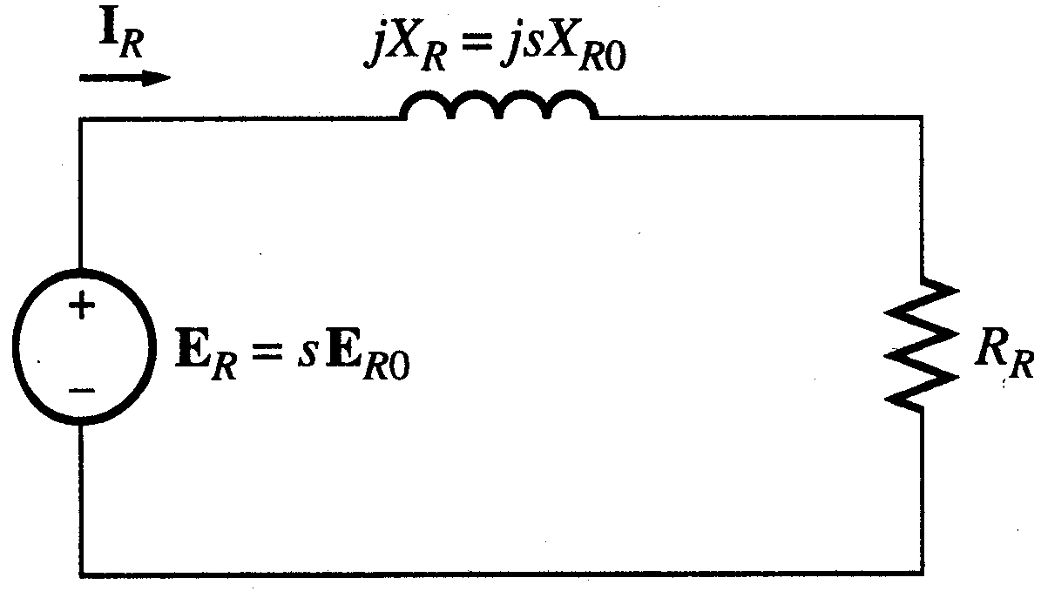
Equivalent Circuit
Then, we can draw the rotor equivalent circuit as follows
Where E_{R} is the induced voltage in the rotor and R_{R} is the rotor resistance

Slide 29
Equivalent Circuit
Now we can calculate the rotor current as
Dividing both the numerator and denominator by s so nothing changes we get
Where E_{R0} is the induced voltage and X_{R0} is the rotor reactance at blocked rotor condition (s = 1)

Slide 30
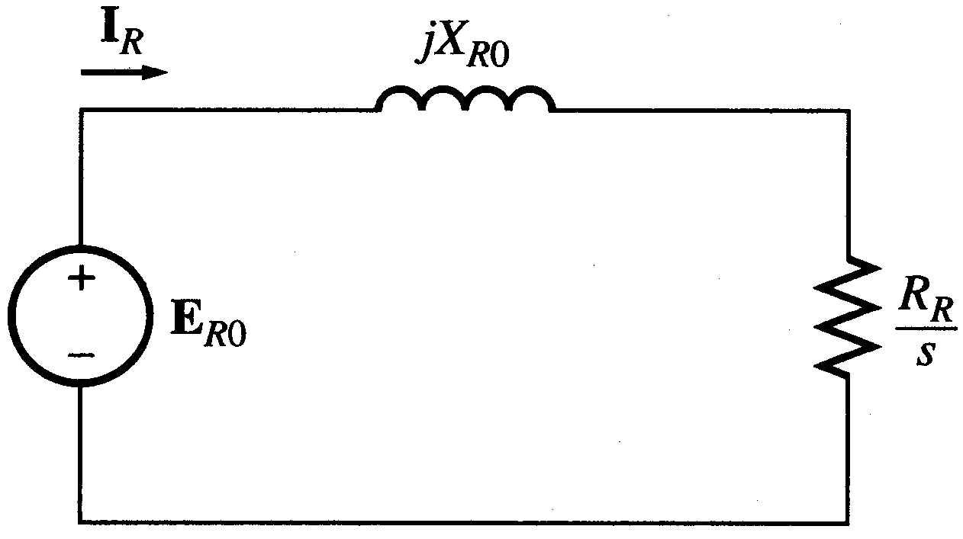
Equivalent Circuit
Now we can have the rotor equivalent circuit

Slide 31
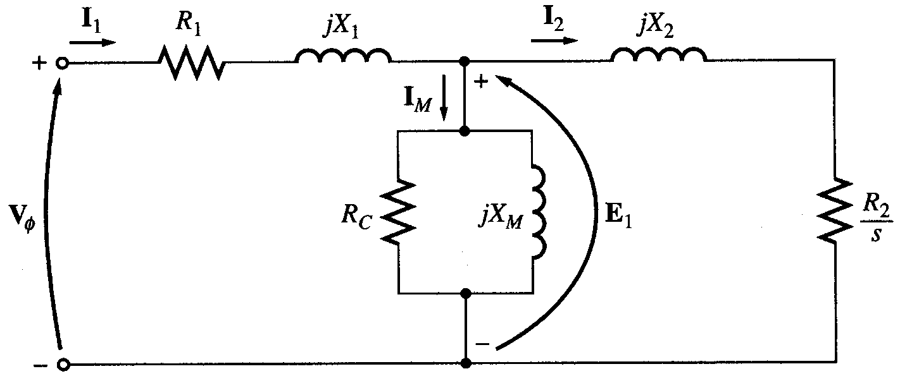
Equivalent Circuit
Now as we managed to solve the induced voltage and different frequency problems, we can combine the stator and rotor circuits in one equivalent circuit
Where

Slide 32
Power losses in Induction machines
Copper losses
Copper loss in the stator (P_{SCL}) = I₁²R₁
Copper loss in the rotor (P_{RCL}) = I₂²R₂
Core loss (P_{core})
Mechanical power loss due to friction and windage
How this power flow in the motor?

Slide 33
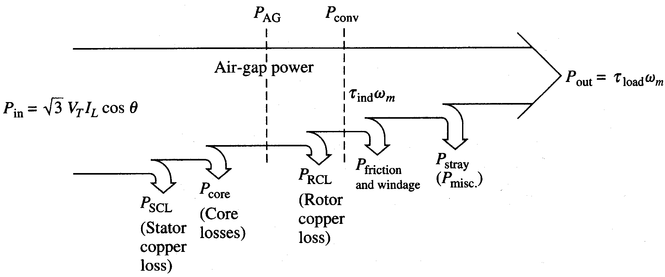
Power flow in induction motor

Slide 34
Power relations

Slide 35
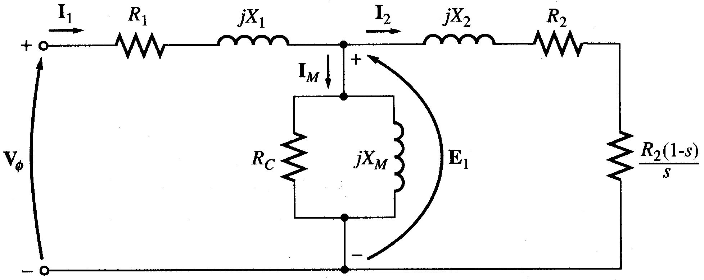
Equivalent Circuit
We can rearrange the equivalent circuit as follows
Resistance equivalent to mechanical load
Actual rotor resistance

Slide 36
Power relations

Slide 37
Power relations
1
1-s
s

Slide 38
Example
A 480-V, 60 Hz, 50-hp, three phase induction motor is drawing 60A at 0.85 PF lagging. The stator copper losses are 2 kW, and the rotor copper losses are 700 W. The friction and windage losses are 600 W, the core losses are 1800 W, and the stray losses are negligible. Find the following quantities:
The air-gap power P_{AG.}
The power converted P_{conv}.
The output power P_{out}.
The efficiency of the motor.

Slide 39
Solution

Slide 40
Solution

Slide 41
Example
A 460-V, 25-hp, 60 Hz, four-pole, Y-connected induction motor has the following impedances in ohms per phase referred to the stator circuit:
R₁= 0.641Ω R₂= 0.332Ω
X₁= 1.106 Ω X₂= 0.464 Ω X_{M}= 26.3 Ω
The total rotational losses are 1100 W and are assumed to be constant. The core loss is lumped in with the rotational losses. For a rotor slip of 2.2 percent at the rated voltage and rated frequency, find the motor’s
Speed
Stator current
Power factor
P_{conv} and P_{out}
τ_{ind} and τ_{load}
Efficiency

Slide 42
Solution

Slide 43
Solution

Slide 44
Solution

Slide 45
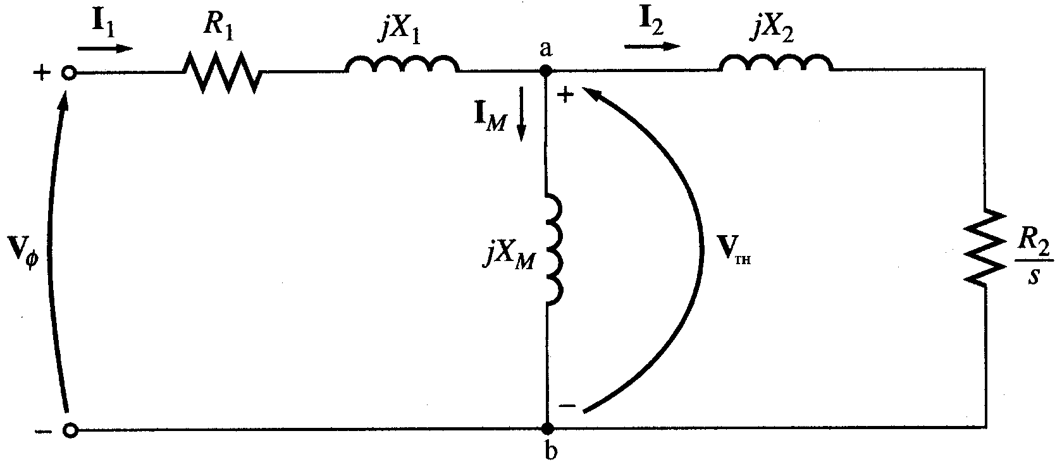
Torque, power and Thevenin’s Theorem
Thevenin’s theorem can be used to transform the network to the left of points ‘a’ and ‘b’ into an equivalent voltage source V_{TH} in series with equivalent impedance R_{TH}+jX_{TH}

Slide 46
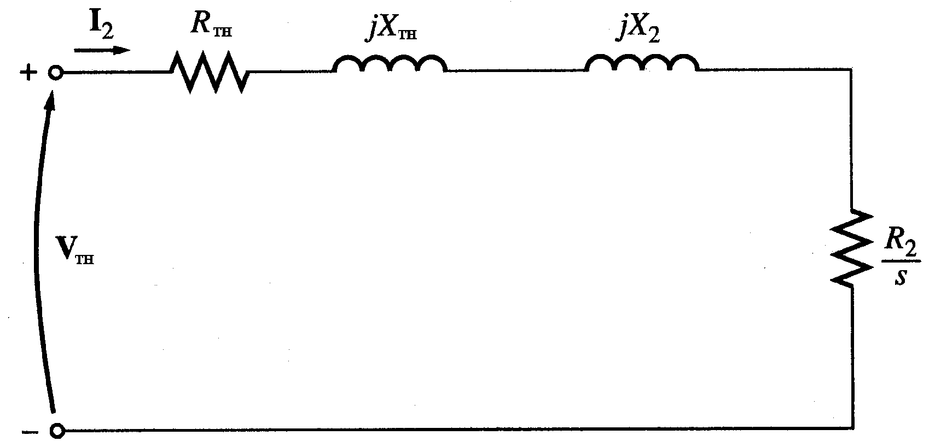
Torque, power and Thevenin’s Theorem

Slide 47
Torque, power and Thevenin’s Theorem
Since X_{M}>>X₁ and X_{M}>>R₁
Because X_{M}>>X₁ and X_{M}+X₁>>R₁

Slide 48
Torque, power and Thevenin’s Theorem
Then the power converted to mechanical (P_{conv})
And the internal mechanical torque (T_{conv})

Slide 49
Torque, power and Thevenin’s Theorem

Slide 50
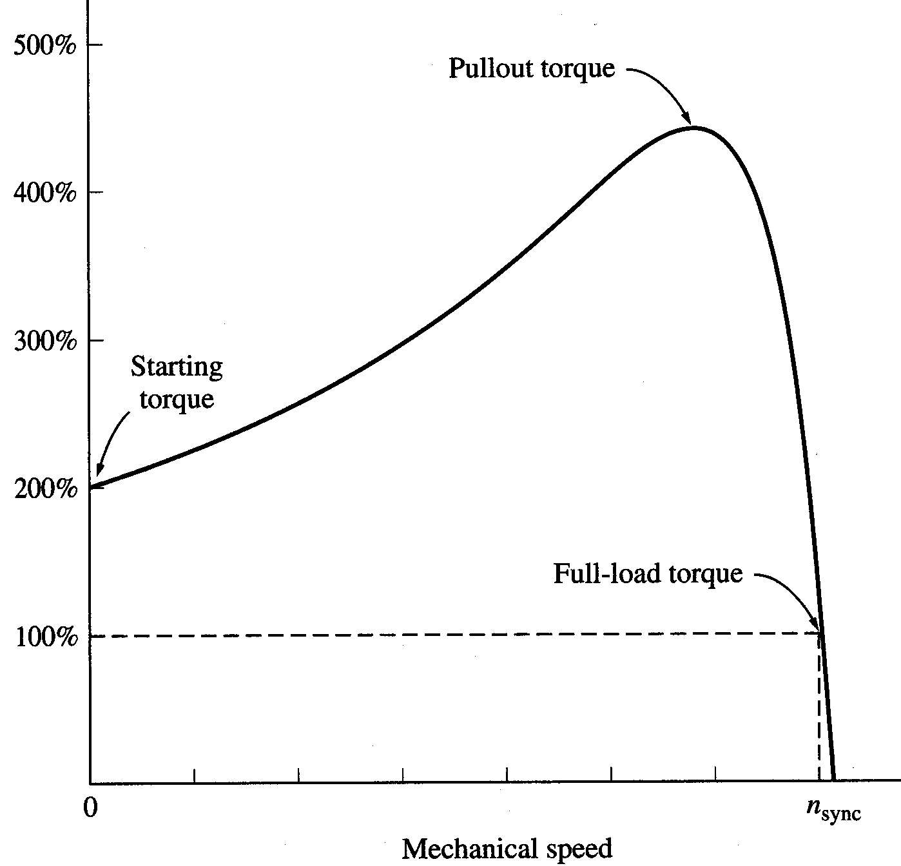
Torque-speed characteristics
Typical torque-speed characteristics of induction motor

Slide 51
Comments
The induced torque is zero at synchronous speed. Discussed earlier.
The curve is nearly linear between no-load and full load. In this range, the rotor resistance is much greater than the reactance, so the rotor current, torque increase linearly with the slip.
There is a maximum possible torque that can’t be exceeded. This torque is called pullout torque and is 2 to 3 times the rated full-load torque.

Slide 52
Comments
The starting torque of the motor is slightly higher than its full-load torque, so the motor will start carrying any load it can supply at full load.
The torque of the motor for a given slip varies as the square of the applied voltage.
If the rotor is driven faster than synchronous speed it will run as a generator, converting mechanical power to electric power.

Slide 53
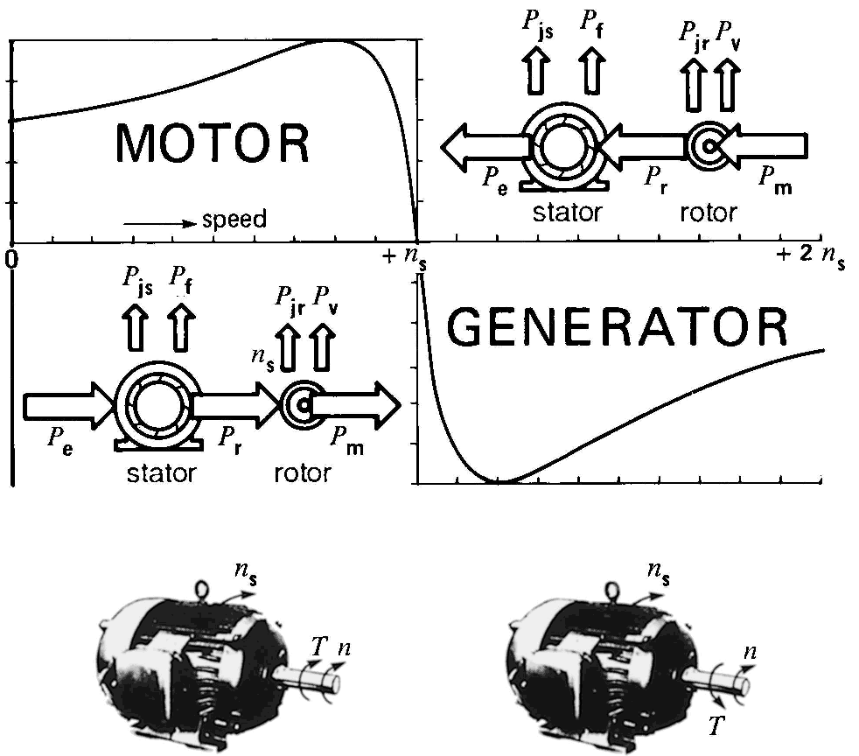
Complete Speed-torque c/c

Slide 54
Maximum torque
Maximum torque occurs when the power transferred to R₂/s is maximum.
This condition occurs when R₂/s equals the magnitude of the impedance R_{TH} + j (X_{TH} + X₂)

Slide 55
Maximum torque
The corresponding maximum torque of an induction motor equals
The slip at maximum torque is directly proportional to the rotor resistance R₂
The maximum torque is independent of R₂

Slide 56
Maximum torque
Rotor resistance can be increased by inserting external resistance in the rotor of a wound-rotor induction motor.
The
value of the maximum torque remains unaffected
but
the speed at which it occurs can be controlled.

Slide 57
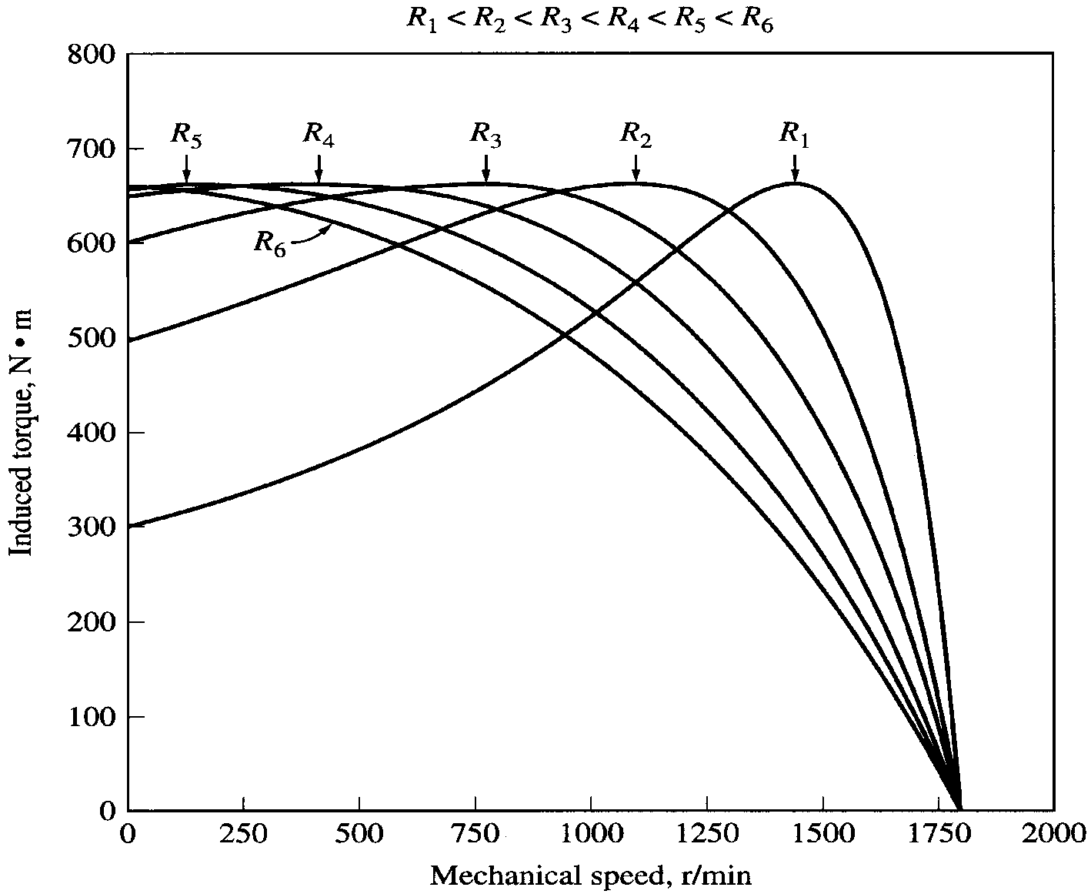
Maximum torque
Effect of rotor resistance on torque-speed characteristic

Slide 58
Example
A two-pole, 50-Hz induction motor supplies 15kW to a load at a speed of 2950 rpm.
What is the motor’s slip?
What is the induced torque in the motor in N.m under these conditions?
What will be the operating speed of the motor if its torque is doubled?
How much power will be supplied by the motor when the torque is doubled?

Slide 59
Solution

Slide 60
Solution
In the low-slip region, the torque-speed curve is linear and the induced torque is direct proportional to slip. So, if the torque is doubled the new slip will be 3.33% and the motor speed will be

Slide 61
Example
A 460-V, 25-hp, 60-Hz, four-pole, Y-connected wound-rotor induction motor has the following impedances in ohms per phase referred to the stator circuit
R₁= 0.641Ω R₂= 0.332Ω
X₁= 1.106 Ω X₂= 0.464 Ω X_{M}= 26.3 Ω
What is the maximum torque of this motor? At what speed and slip does it occur?
What is the starting torque of this motor?
If the rotor resistance is doubled, what is the speed at which the maximum torque now occur? What is the new starting torque of the motor?
Calculate and plot the T-s c/c for both cases.

Slide 62
Solution

Slide 63
Solution
The corresponding speed is

Slide 64
Solution
The torque at this speed is

Slide 65
Solution
The starting torque can be found from the torque eqn. by substituting s = 1

Slide 66
Solution
If the rotor resistance is doubled, then the slip at maximum torque doubles too
The corresponding speed is
The maximum torque is still
τ_{max} = 229 N.m

Slide 67
Solution
The starting torque is now

Slide 68
Determination of motor parameters
Due to the similarity between the induction motor equivalent circuit and the transformer equivalent circuit, same tests are used to determine the values of the motor parameters.
DC test: determine the stator resistance R₁
No-load test: determine the rotational losses and magnetization current (similar to no-load test in Transformers).
Locked-rotor test: determine the rotor and stator impedances (similar to short-circuit test in Transformers).

Slide 69
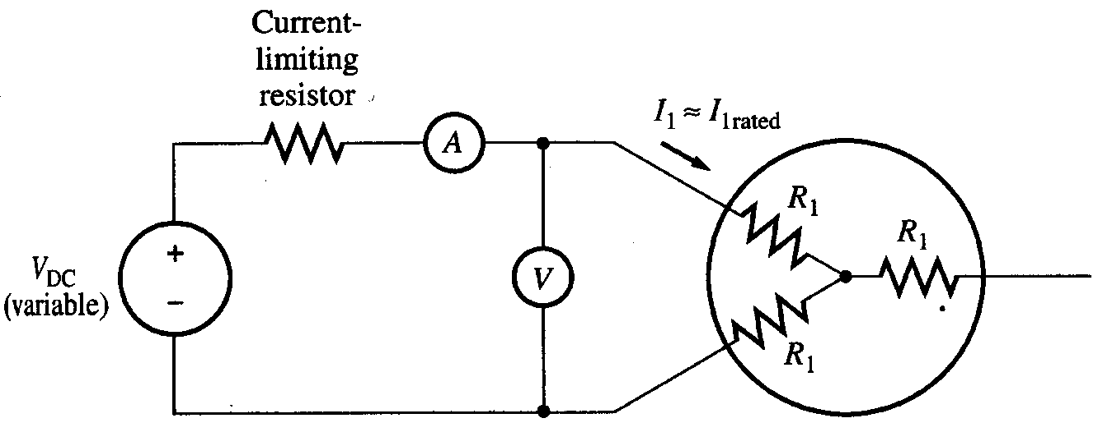
DC test
The purpose of the DC test is to determine R₁. A variable DC voltage source is connected between two stator terminals.
The DC source is adjusted to provide approximately rated stator current, and the resistance between the two stator leads is determined from the voltmeter and ammeter readings.

Slide 70
DC test
then
If the stator is Y-connected, the per phase stator resistance is
If the stator is delta-connected, the per phase stator resistance is

Slide 71
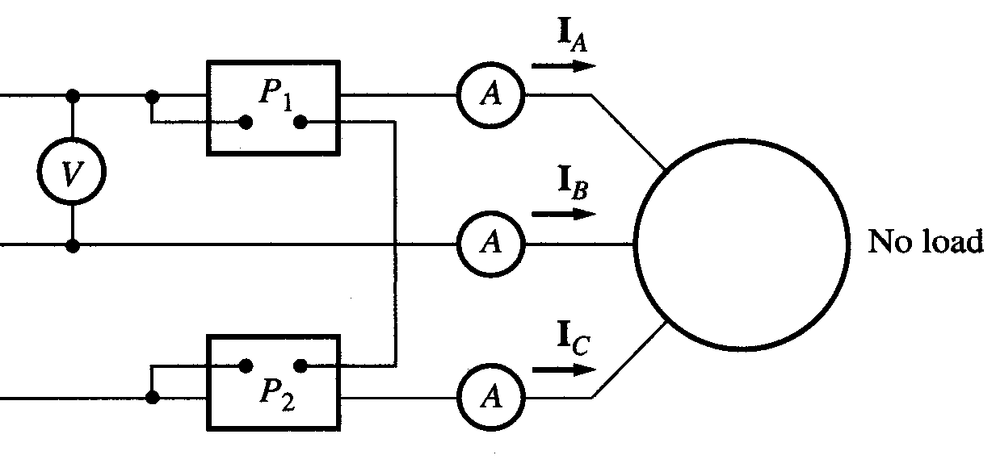
No-load test
The motor is allowed to spin freely
The only load on the motor is the friction and windage losses, so all P_{conv} is consumed by mechanical losses
The slip is very small

Slide 72
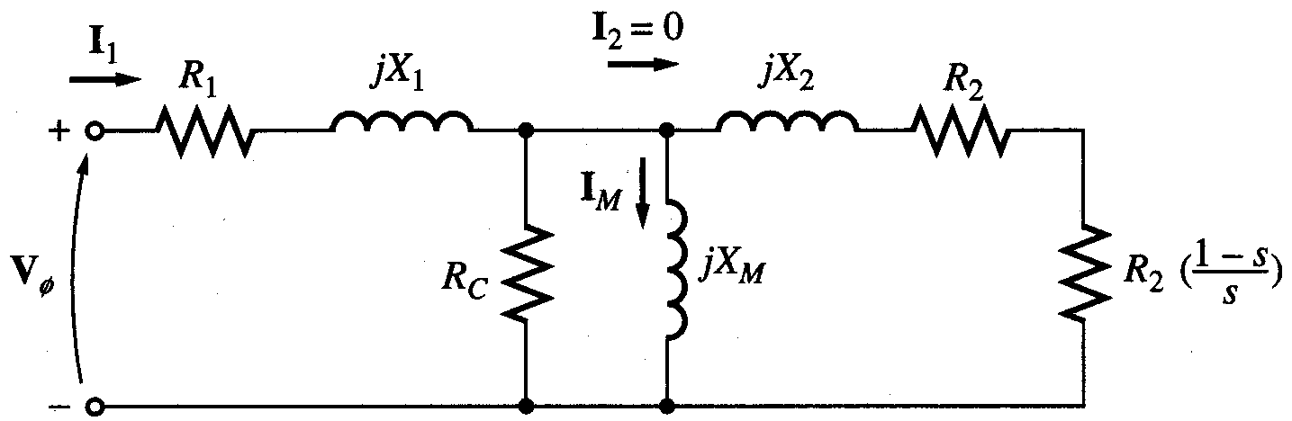
No-load test
At this small slip
The equivalent circuit reduces to…

Slide 73
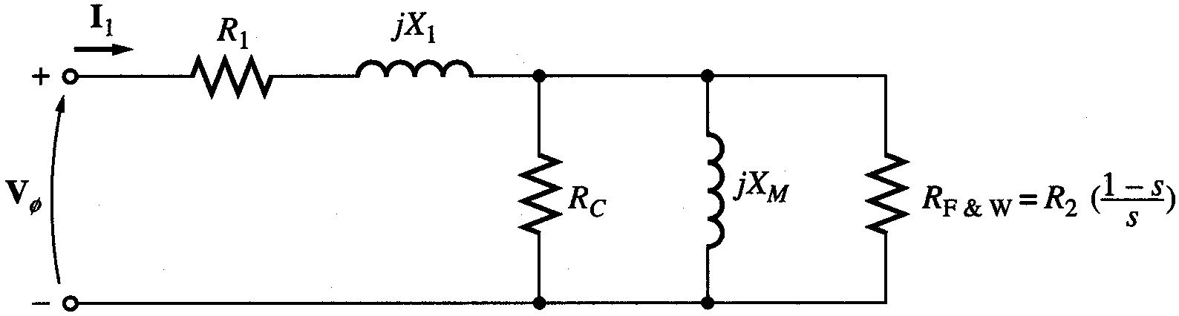
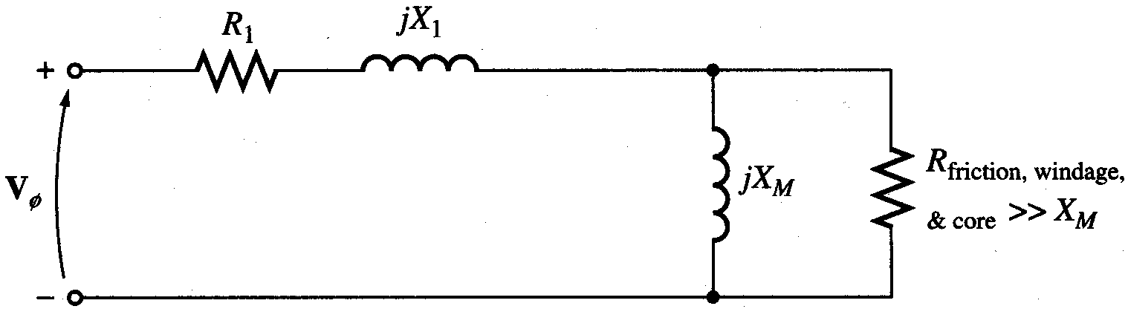
No-load test
Combining R_{c} & R_{F+W} we get……

Slide 74
No-load test
At the no-load conditions, the input power measured by meters must equal the losses in the motor.
The P_{RCL} is negligible because I₂ is extremely small because R₂(1-s)/s is very large.
The input power equals
Where

Slide 75
No-load test
The equivalent input impedance is thus approximately
If X₁ can be found, in some other fashion, the magnetizing impedance X_{M} will be known

Slide 76
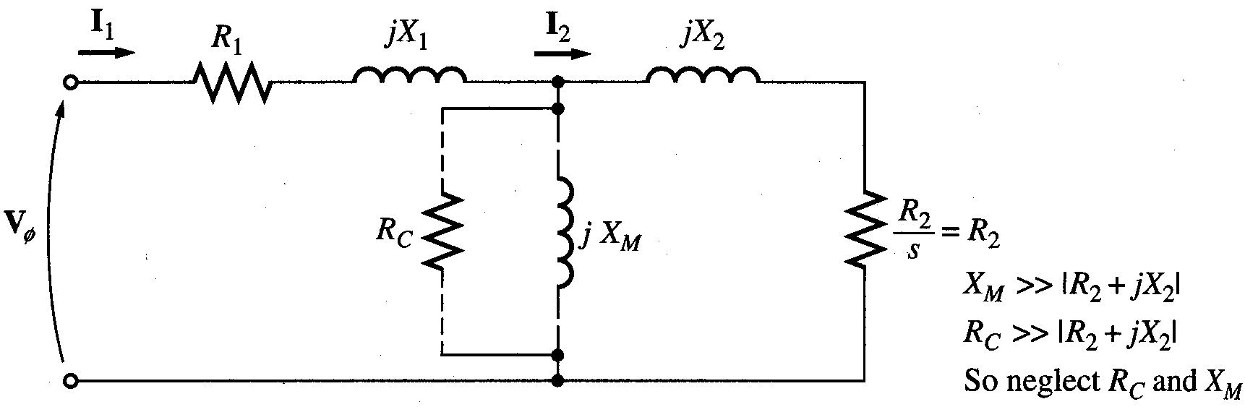
Blocked-rotor test
In this test, the rotor is locked or blocked so that it cannot move, a voltage is applied to the motor, and the resulting voltage, current and power are measured.

Slide 77
Blocked-rotor test
The AC voltage applied to the stator is adjusted so that the current flow is approximately full-load value.
The locked-rotor power factor can be found as
The magnitude of the total impedance

Slide 78
Blocked-rotor test
Where X’₁ and X’₂ are the stator and rotor reactances at the test frequency respectively

Slide 79
Blocked-rotor test
 | X₁ and X₂ as function of X_{LR}
Rotor Design | X₁ | X₂
Wound rotor | 0.5 X_{LR} | 0.5 X_{LR}
Design A | 0.5 X_{LR} | 0.5 X_{LR}
Design B | 0.4 X_{LR} | 0.6 X_{LR}
Design C | 0.3 X_{LR} | 0.7 X_{LR}
Design D | 0.5 X_{LR} | 0.5 X_{LR}

Slide 80
Example
The following test data were taken on a 7.5-hp, four-pole, 208-V, 60-Hz, design A, Y-connected IM having a rated current of 28 A.
DC Test:
V_{DC} = 13.6 V I_{DC} = 28.0 A
No-load Test:
V_{l} = 208 V f = 60 Hz
I = 8.17 A P_{in} = 420 W
Locked-rotor Test:
V_{l} = 25 V f = 15 Hz
I = 27.9 A P_{in} = 920 W
Sketch the per-phase equivalent circuit of this motor.
Find the slip at pull-out torque, and find the value of the pull-out torque.

